Slide 1

Introduction to NBA Sponsor Growth Analysis
The National Basketball Association (NBA), a premier professional basketball league, boasts a robust sponsorship ecosystem. This project delves into this world using data analytics to understand sponsorship growth trends. We explore partnerships between the NBA and companies (league-level) as well as individual teams and sponsors (team-level).
Our goal? To uncover hidden patterns and predict the future success of NBA sponsorships. We analyze data on over 150 companies spanning a decade, identifying a significant positive impact (73%) on sponsor revenue.
This project leverages data analytics to unlock valuable insights for the future of NBA sponsorships. We leverage the power of Python, machine learning, and cutting-edge data visualization tools like Power BI to unlock these insights.
Group members:
2106207 Diksha Singh
2106275 Vivek Shivam Saharia
2106270 Suraj Kumar Nayak
2106279 Tarun Kumar

Slide 2
Problem Statement & Requirement Specifications
The National Basketball Association (NBA) is a powerhouse in the world of sports, boasting immense popularity and commercial success. However, to maintain this momentum, understanding sponsor growth trends is critical. This knowledge empowers the NBA to optimize its sponsorship programs and attract even more valuable partners. Traditional methods for analyzing sponsor growth may lack a structured approach or rely heavily on subjective interpretations
Bridging the Gap with Data Analytics
Project stages:
Current sponsor growth analysis methods may:
i. Data collection from various sources
Lack a systematic approach
ii. Performing Linear Discriminant Analysis (LDA)
Rely on subjective assessments
iii. Implementing Logistic Regression (Machine Learning)
This project bridges the gap by leveraging:
Data analytics
iv. Predicting growth or decline trends
Machine learning concepts
To forecast NBA sponsor growth

Slide 3
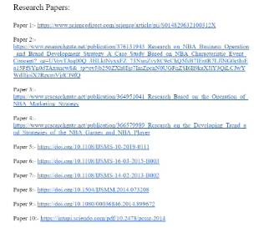
Literature Review
Literature Review
A selection of relevant research papers have been reviewed to gain insights into the current landscape of NBA sponsorships.
Gap & Potential Interpretation
Traditionally, sponsor growth analysis might have relied on:
Subjective interpretations
Limited data sets
Our project seeks to bridge this gap by:
Leveraging data analytics
Employing machine learning techniques
Offering a more objective and data-driven approach
Nobility & Potential Interpretation
To our knowledge, there is no existing research on analyzing and predicting sponsor growth trends within the NBA using data analytics and machine learning techniques.
Our project's novelty lies in:
Applying these techniques to the specific context of NBA sponsorships
Contributing to a more comprehensive understanding of the sponsorship landscape
Informing more effective sponsorship strategies

Slide 4
Methodology
Data Source
1
Reliable sources ensured data quality: Official NBA financial reports, Sponsorship databases, Industry reports on sports marketing and sponsorship trends
2
Data Cleaning and Preprocessing (using Python)
Python for data wrangling: Missing value handling, Duplicate removal, Data format standardization, Variable transformation. Pandas library simplifies tasks
Linear Discriminant Analysis
3
LDA for feature importance: Identified key differentiators for successful sponsorships Shed light on factors driving growth Foundation for predictive modeling
4
Classification Modeling with Logistic Regression
Predicting Sponsor Growth: Logistic Regression Model
Prediction and Interpretation
5
Building on LDA's insights: Logistic regression for growth prediction, Ideal for binary classification (successful/unsuccessful)
Using a logistic regression model, we predicted sponsor growth for NBA teams. By analyzing the model's results, we identified key drivers like team performance, market size, and brand fit. This provided valuable insights for clients to optimize their NBA sponsorship strategies.
6
Data Visualization
We created interactive dashboards using Microsoft Power BI to effectively communicate our NBA sponsor growth findings. Power BI's rich set of visualizations allowed us to present data in a clear and engaging way, empowering clients to explore trends and gain their own insights.

Slide 5
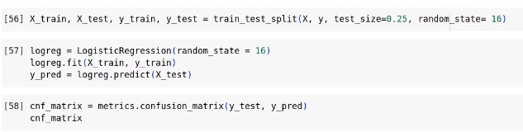

Logistic Regression Model Development
Logistic regression is a statistical method used for classification tasks.
Model Training and Testing
It is used to estimate the probability of an event occurring, such as a company growing.
The code trains a logistic regression model on training data and evaluates its performance on unseen testing data using confusion matrix and classification report.
Logistic regression uses a sigmoid function to map the linear combination of input features to a probability between 0 and 1.
Data Preparation
The code imports necessary libraries such as pandas, numpy, and matplotlib.
Prediction
It reads the CSV data into a pandas DataFrame.
The code handles missing values and data cleaning.
The code provides a user-friendly interface to predict sponsor growth potential for new companies based on their revenue changes.
It then separates the features (previous year profit, current year profit) and target variable (growth)

Slide 6
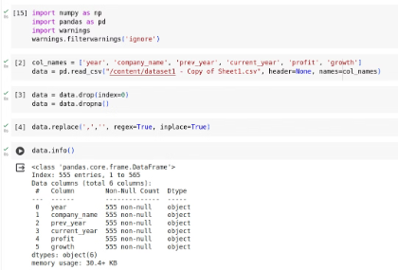
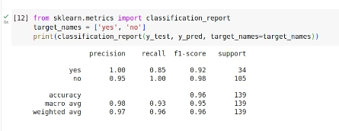
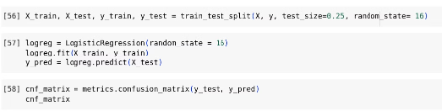
Model Evaluation and Validation
1
Code Initialization
2
Model Accuracy
To ensure our model accurately predicts sponsor growth, we'll split data for training and testing. The model "learns" from training data and its performance is evaluated on unseen testing data using metrics like confusion matrix and classification report. This helps us understand how well the model predicts sponsor growth within the NBA.
3
Model Evaluation
4
The Goal:
In model evaluation, splitting data into training and testing sets is crucial. Metrics like confusion matrix and classification report analyze the model's performance on the testing data. This tells us how well the model generalizes its learnings from training data to predict growth for new sponsors within the NBA.
By analyzing these metrics, we can gauge the model's ability to generalize its learnings and accurately predict the growth trajectory of new sponsors within the NBA landscape. This validation process helps us identify any weaknesses in the model and allows for further refinement before relying on its predictions for real-world decisions.

Slide 7
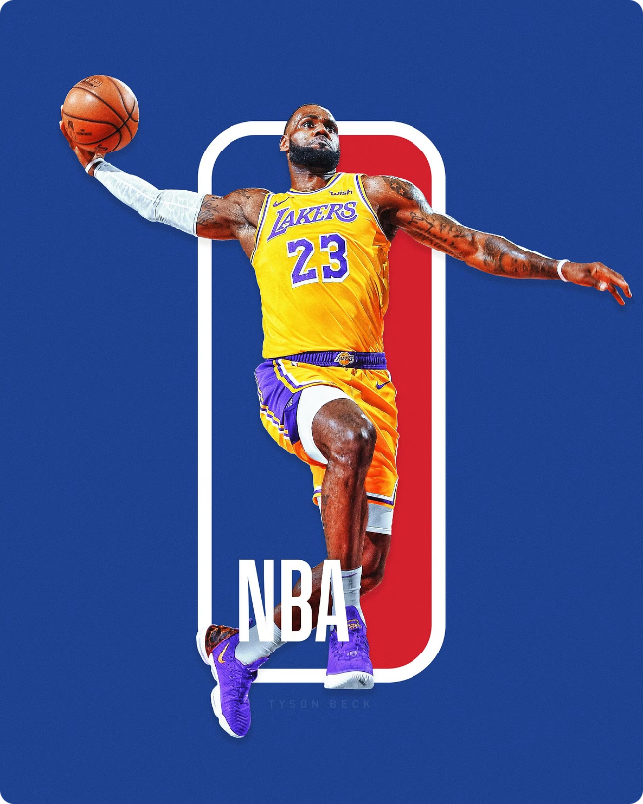
Advantages of the NBA Sponsor Growth Project:
This project empowers the NBA with data-driven insights to optimize sponsorships.
Smarter Decisions: Replaces guesswork with objective data, leading to better strategic choices for sponsor acquisition and program development.
Actionable Intelligence: Identifies growth trends and future potential, allowing the NBA to prioritize high-growth sponsor categories and tailor programs for maximum impact.
Broad Applicability: The methodology can be used by other sports leagues and even different industries to analyze sponsor growth.
Increased Efficiency: Data analytics automates tasks and allows for a wider analysis of sponsorship data, saving time and resources.
Deeper Understanding: The project pinpoints key factors driving sponsor growth, enabling the NBA to better understand and cater to sponsor needs.

Slide 8
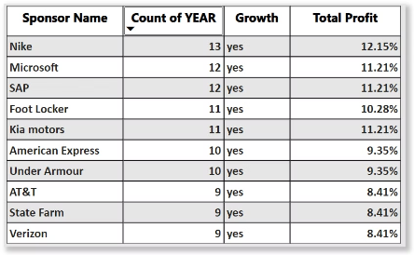
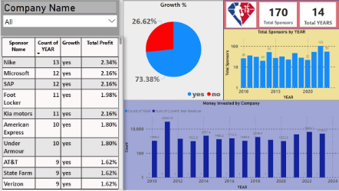
Results and Insights
Top Sponsors and Growth
170 unique sponsors identified over 14 years
73% of sponsors experienced growth
Companies with longer sponsorships (over 5 years) showed a higher growth rate
Impact of COVID-19
Sponsorships declined in 2020 due to COVID-19 pandemic
Many companies refrained from investing or experienced losses
Growth rebounded in 2021 and 2022 as the market recovered

Slide 9
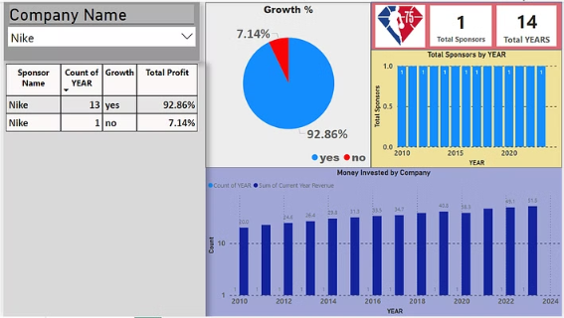
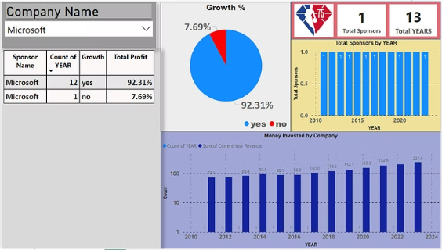
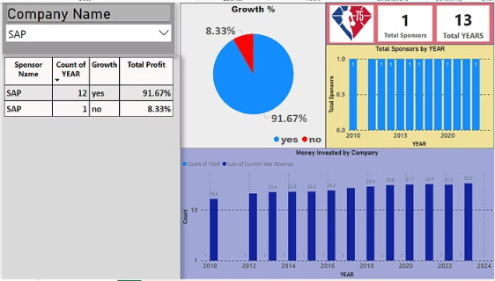
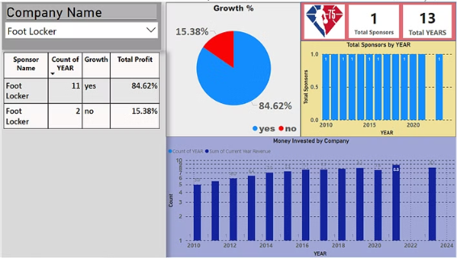
Visualizing Sponsor Growth with Power BI
Top 4 Companies

Slide 10


Conclusion and Future Scope
Limitations
Data Constraints
Limited historical data
Potential inconsistencies across data sources
Difficulty accessing social media data
Modeling Considerations
Assumptions of logistic regression
Risk of overfitting
Need to explore alternative models
External Influences
Economic fluctuations
Evolving consumer preferences
Future Scope
Leverage data on sponsor mentions and brand sentiment analysis to gain deeper insights.
Analyze the correlation between media conversations and sponsor growth.
Identify the most effective social media platforms for different sponsorships.
As the sports industry continues to evolve and become more data-driven, the insights and methodologies presented in this study will serve as a valuable resource for organizations seeking to optimize their sponsorship strategies and capitalize on the growing opportunities within the NBA and beyond. By leveraging the power of data analytics and machine learning, the NBA and its partners can stay ahead of the curve, making informed decisions that drive long-term growth and engagement with their passionate fan base.

